Slide 1
X-CALI
Control Systems
Mechanical Design
Microprocessor Programming
Communication Systems
Algorithm Design
Hande Bayazıt
Oytun Akpulat
Taha Doğan
Burak Sezgin
Emre Doğan
Taha Doğan
Burak Sezgin
Oytun Akpulat

Slide 2
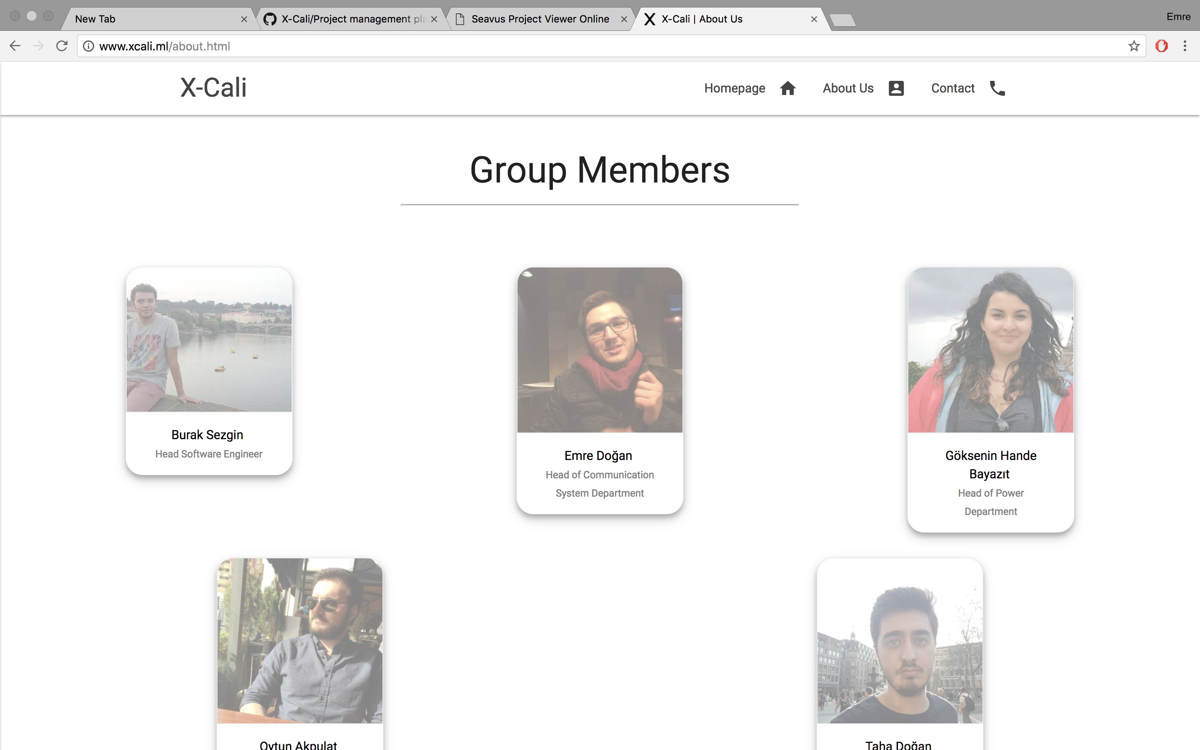
http://www.xcali.ml/

Slide 3
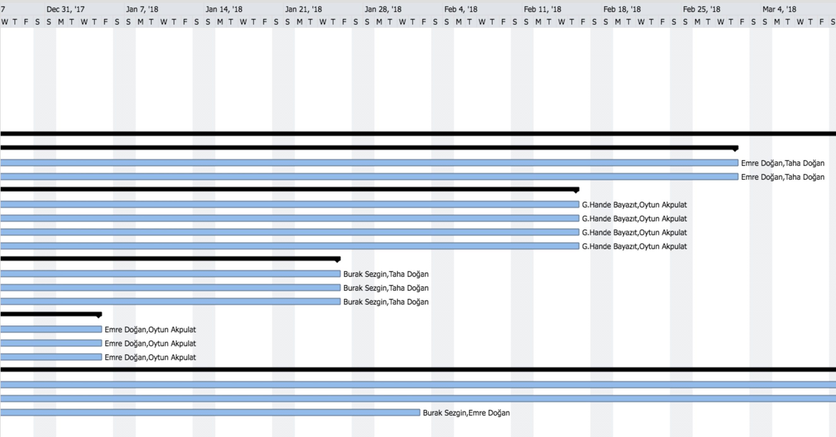
Package Management

Slide 4
Cost Analysis and Funding
Product Name | Price Per Product | Quantity | Total Price
Raspberry Pi 3 | 181.65 ₺ | 1 | 181.65₺
HC-SR04 Arduino Ultrasonic Distance Sensor | 5.50₺ | 4 | 22.00₺
E18 D80NK Infrared Sensor | 22.75₺ | 4 | 91.00₺
Logitech C270 Webcam | 115.75₺ | 1 | 115.75₺
L298N Motor Driver | 12.00₺ | 1 | 12.00₺
Ball transfer unit | 4.20₺ | 1 | 4.20₺
Robot Chassis & Wheels | 50.00₺ | 1 | 50.00₺
Jumper Cables | 10.00₺/set | 1 | 10.00₺
11.1V 1300mA LIPO Battery | 69.50₺ | 1 | 69.50₺
LIPO Battery Charger | 45.00₺ | 1 | 45.00₺
24V-5V 3A DC to DC USB Power Module | 6.65₺ | 1 | 6.65₺
 |  | TOTAL PRICE | 607.75₺

Slide 6
Project Deliverables
The Work Package | Corresponding Deliverable
Research | Tentative Report
Component Tests | Results and analysis of the component tests
Communications Subsystem Design | Results of the procedure of receiving& processing data
Mechanical Subsystem Design | Driving tests and analysis of the robot’s performance
Software Subsystem Design | Documentation of the algorithms and debugging results
Overall System Implementation& Tests | A robot completing the labyrinth by itself
Demonstration | A robot completing the labyrinth collaboratively with the other groups. The product within its package.

Slide 7
Product Deliverables
PDF Version of the Manual
www.xcali.ml/about.html

Slide 9
Customer Care
2 year warranty supplied.
Maintenance & Repair.
http://xcali.ml/contact.html

Slide 10
Foreseeable Difficulties

